Slide 1

Li-Fi Technology
Presented By
Yash Vardhan Mishra (1804350)
Akash Pande (1804355)
Anish Mahatha (1804357)
Md.Farhan (1804388)
Akanksha Singh (1804423)

Slide 2

1) Wi-Fi and its Problem
2) Li-Fi itechnology
CONTENTS
3) Application
4)Conclusion

Slide 3

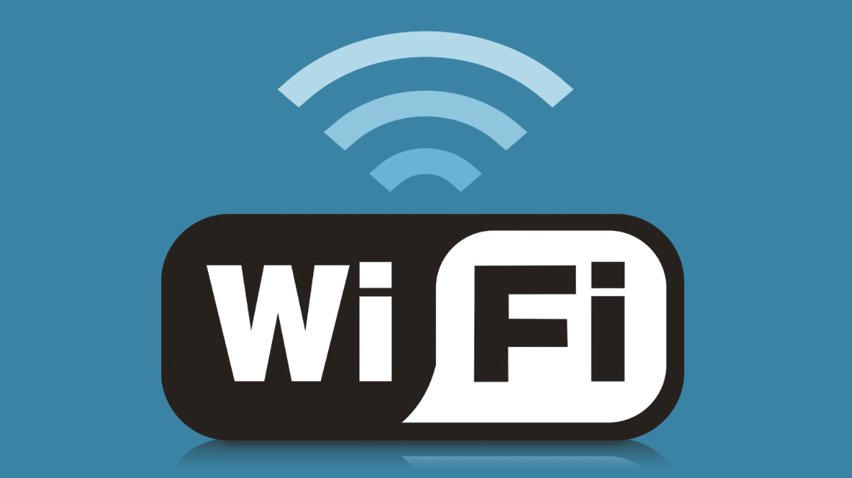
1
Wi-Fi Technology
Wi-Fi stands for wireless fidelity.It is a family of wireless network protocols, based on the IEEE 802.11 family of standards, which are commonly used for local area networking of devices and Internet access, allowing nearby digital devices to exchange data by radio waves. In the same way a radio can tune into a radio station signal over the airwaves, your device can pick up a signal that connects it to the internet through the air. It is a high-frequency radio signal.And the same way that the frequency of a radio station is regulated, the standards for Wi-Fi are as well. All the electronic components that make up a wireless network such as router, these are based on 802.11 standards that were set by the Institute of Electrical and Electronics Engineers and the Wi-Fi Alliance. The Wi-Fi alliance trademarked the name Wi-Fi and promoted the technology. The technology is also referred to as wireless local area network. However, Wi-Fi has definitely become the more popular expression used by most people.

Slide 4
History
In 1971, ALOHAnet connected the Great Hawaiian Islands with a UHF wireless packet network. ALOHAnet and the ALOHA protocol were early forerunners to Ethernet, and later the Institute of Electrical and Electronics Engineers [ IEEE 802.11] protocols, respectively.A 1985 ruling by the U.S. Federal Communications Commission released the band for unlicensed use. These frequency bands are the same ones used by equipment such as microwave ovens and are subject to interference.The technical birthplace of Wi-Fi is The Netherlands.
In 1991, NCR Corporation with American Telephone & Telegraph company invented the first wireless products were under the name WaveLAN. They are the ones credited with inventing Wi-Fi. NCR's Vic Hayes, who held the chair of IEEE 802.11 for 10 years, along with Bell Labs Engineer Bruce Tuch, approached IEEE to create a standard and were involved in designing the initial 802.11b and 802.11a standards within the IEEE. They have both been subsequently inducted into the Wi-Fi NOW Hall of Fame.The first version of the 802.11 protocol was released in 1997, and provided up to 2 Mbit/s link speeds. This was updated in 1999 with 802.11b to permit 11 Mbit/s link speeds, and this proved popular.Later Vic Hayes is also known as father of Wi-Fi.

Slide 5
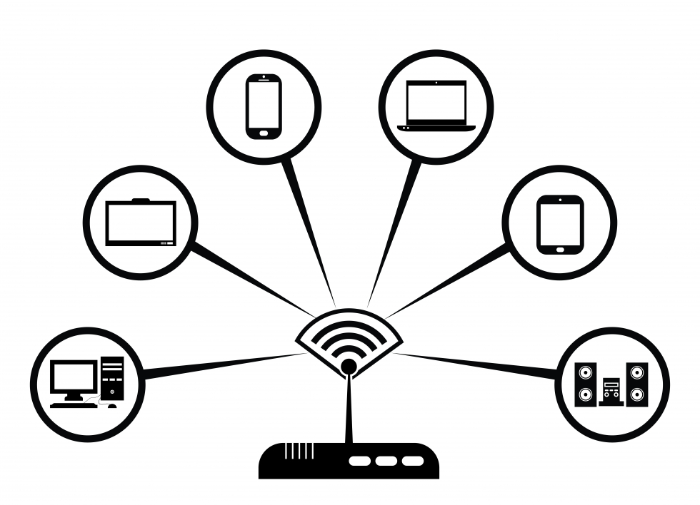
Arrows Diagram
Connection Of Wi-Fi in Different devices

Slide 6
USES OF Wi-Fi
Home
Appliences
Tablets
Mobile
Laptops
Gaming
Console
Tablets
Local Area
Network
Digital
printers
Broad Bands
Internet
Access
Personal
Computers
Tablets
Used in Diffetent
public places
Airports
Railway
Station
Book Stores
Large Shopes

Slide 7

Problems Of Wi-Fi
Wi-Fi affecting the Environment
Wi-Fi is affecting our environment in negative way .Radio Wave signals is harmful for Plants , Animals, Human beings and Specially for Birds.
Many Birds causes death due to Radio Wave signals
Speed Of Wi-Fi
Speed of light is very High as compare to Radio Wave Signals.
Security Issue
Idea
Haking- Any Outsider Can enter in your Network if only he gain your password or he can crack your password
Suitable for all categories business and personal presentation

Slide 8

Li-Fi Technology
2
Li-Fi (also Known Light Fidelity) is a wireless communication technology which utilizes light to transmit data and position between devices. The term was first introduced by Harald Haas during a 2011 TEDGlobal talk in Edinburgh.
In technical terms, Li-Fi is a light communication system that is capable of transmitting data at high speeds over the visible light, ultraviolet, and infrared spectrums. In its present state, only LED lamps can be used for the transmission of data in visible light.
In terms of its end use, the technology is similar to Wi-Fi — the key technical difference being that Wi-Fi uses radio frequency to induce a voltage in an antenna to transmit data, whereas Li-Fi uses the modulation of light intensity to transmit data. Li-Fi can theoretically transmit at speeds of up to 100 Gbit/s. Li-Fi's ability to safely function in areas otherwise susceptible to electromagnetic interference (e.g. aircraft cabins, hospitals, military) is an advantage.The technology is being developed by several organizations across the globe.

Slide 9
History
Professor Harald Haas coined the term "Li-Fi" at his 2011 TED Global Talk where he introduced the idea of "wireless data from every light". He is Professor of Mobile Communications at the University of Edinburgh, and the co-founder of pureLiFi along with Dr Mostafa Afgani.
The general term "visible light communication" (VLC), whose history dates back to the 1880s, includes any use of the visible light portion of the electromagnetic spectrum to transmit information. The D-Light project at Edinburgh's Institute for Digital Communications was funded from January 2010 to January 2012.Haas promoted this technology in his 2011 TED Global talk and helped start a company to market it.PureLiFi, formerly pureVLC, is an original equipment manufacturer (OEM) firm set up to commercialize Li-Fi products for integration with existing LED-lighting systems.
In October 2011, a research organisation Fraunhofer IPMS and industry Companies formed the Li-Fi Consortium, to promote high-speed optical wireless systems and to overcome the limited amount of radio-based wireless spectrum available by exploiting a completely different part of the electromagnetic spectrum.
A number of companies offer uni-directional VLC products, which is not the same as Li-Fi - a term defined by the IEEE 802.15.7r1 standardization committee.
VLC technology was exhibited in 2012 using Li-Fi. By August 2013, data rates of over 1.6 Gbit/s were demonstrated over a single color LED. In September 2013, a press release said that Li-Fi, or VLC systems in general, do not require line-of-sight conditions. In October 2013, it was reported Chinese manufacturers were working on Li-Fi development kits.

Slide 10
Principle
ANY SIGNAL
By Using Light
LIFI SIGNAL
By Using Solar Panel Or Sensors
RECEIVING SIGNAL

Slide 11
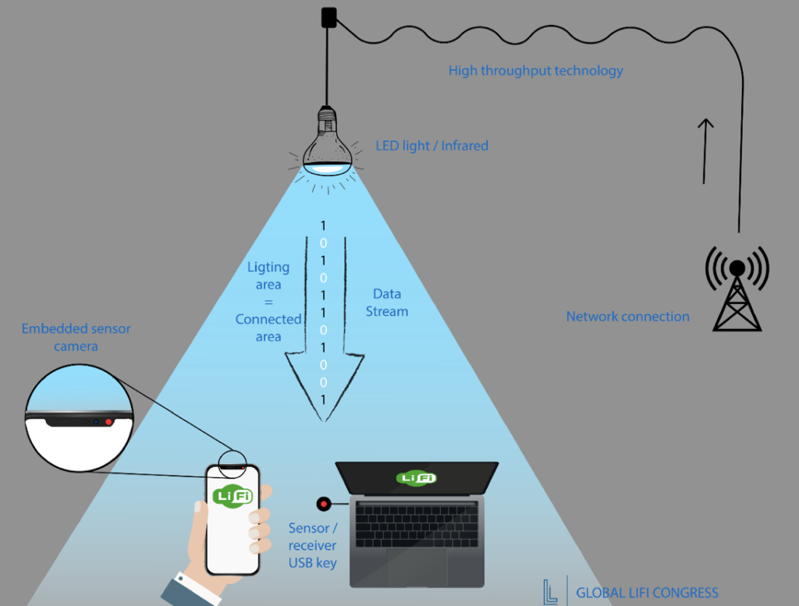
Diagram
Connection Of Li-Fi in Different devices

Slide 12
USES OF Li-Fi
Home
Appliences
Mobile
Laptops
Gaming
Console
Tablets
Tablets
Local Area
Network
Digital
printers
Broad Bands
Internet
Access
Personal
Computers
Tablets
Used in Diffetent
public places
Airports
Railway
Station
Book Stores
Large Shopes
Li-Fi is used Every Where in Place of Wi-Fi

Slide 13

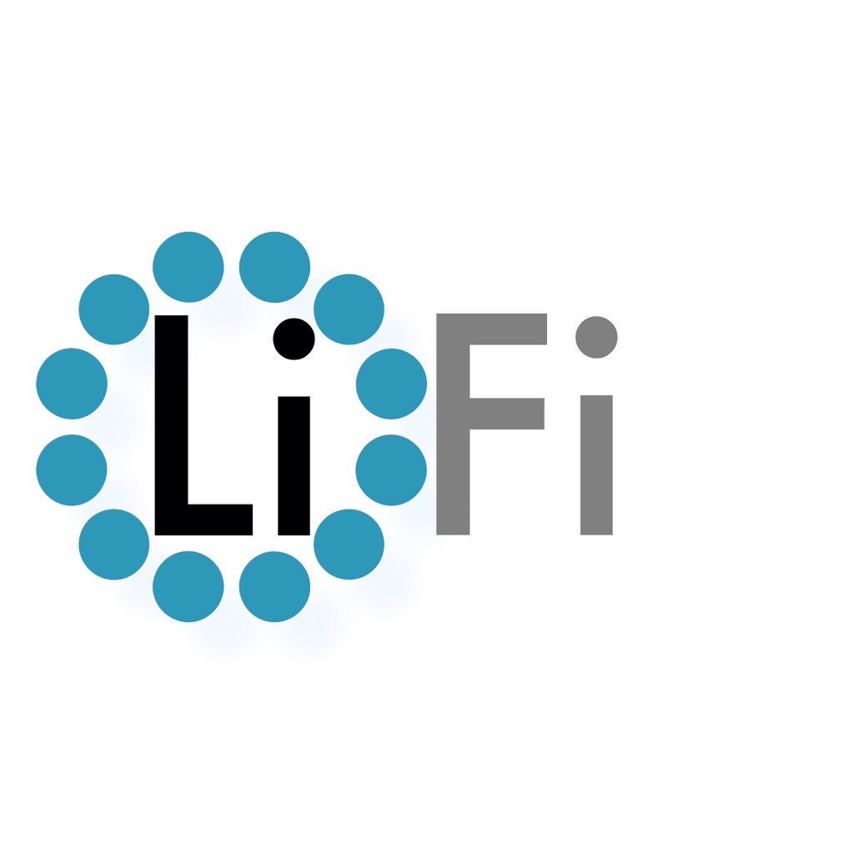
Advantages Of Li-Fi
Li-Fi affecting the Environment
Li-Fi Can not affecting the environment as comparing to Radio Wave Signals.
So I want to say that use Li-FI and Protect our Natural Environment
Speed Of Li-Fi
Speed of light is Extermely High as compare to Radio Wave Signals.
Best Security
No one Can Acess your Network Outside the wall . Because light can not pass through the wall and even your data is also secure because data is also in the form of light.

Slide 14
3
Application
Underwater application:-
Most remotely operated underwater vehicles (ROVs) are controlled by wired connections. The length of their cabling places a hard limit on their operational range, and other potential factors such as the cable's weight and fragility may be restrictive. Since light can travel through water, Li-Fi based communications could offer much greater mobility. Li-Fi's utility is limited by the distance light can penetrate water. Significant amounts of light do not penetrate further than 200 meters. Past 1000 meters, no light penetrates.
Vehicles:-
Vehicles could communicate with one another via front and back lights to increase road safety. Street lights and traffic signals could also provide information about current road situations.

Slide 15
More Application
Hospital:-
Many treatments now involve multiple individuals, Li-Fi systems could be a better system to transmit communication about the information of patients.Besides providing a higher speed, light waves also have little effect on medical instruments. Wireless communication can be done during the use of such medical instruments without having to worry about radio interferences hindering the efficiency of the task.
Aviation:-
Efficient communication of data is possible in airborne environments such as a commercial passenger aircraft utilizing Li-Fi. Using this light-based data transmission will not interfere with equipment on the aircraft that relies on radio waves such as its radar.
Industrial automation:-
Anywhere in industrial areas data has to be transmitted, Li-Fi is capable of replacing slip rings, sliding contacts and short cables, such as Industrial Ethernet. Due to the real time of Li-Fi (which is often required for automation processes) it is also an alternative to common industrial Wireless LAN standards. Fraunhofer IPMS, a research organisation in Germany states that they have developed a component which is very appropriate for industrial applications with time sensitive data transmission.

Slide 16
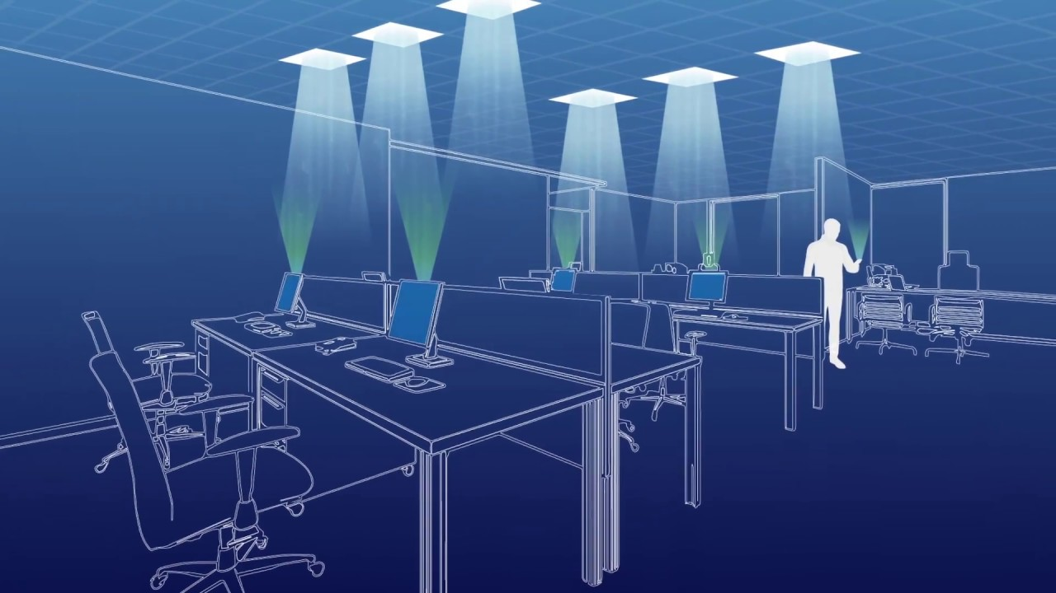
Diagram
Use Of Li-Fi in the Office[Bussiness Purposes]

Slide 17
4
Conclusion
From the following presentation we were able to learn about the Wi-Fi & its Problem, lifi and its construction, working, and its uses or application .We also learned that why the Lifi is more faster than wifi and it is more secure Network than Wi-Fi. It is also used in under Water Application .
At last I would like to conclude that Li-Fi is better then Wi-Fi in Most Of the Cases.

Slide 18
THANK YOU

